Slide 1
Data Engineering HW1
Question 2

Slide 2
General Steps
1- mkdir dags data logs plugins
2- init airflow
docker-compose up -d airflow-init
3-get the docker compose up
docker-compose up
5- sql to container then excute the sql qurey
docker cp ./sql.sql postgres:/file.sql
docker cp ./loan_data_set.csv postgres:/file.csv
docker exec -u postgres postgres psql postgres postgres -f /file.sql
docker exec airflow_web mkdir -p /home/airflow/data
6- go to file dags that contain "dag.py" and run it
7- you can now access Airflow on "localhost:8080"
then you will have "DataEngineeringHW1_Q2" DAG , run it
8- you will find the json file in the data file, you can also access the mongo-express on port 8081 to see
the json file pushed to mongo

Slide 3
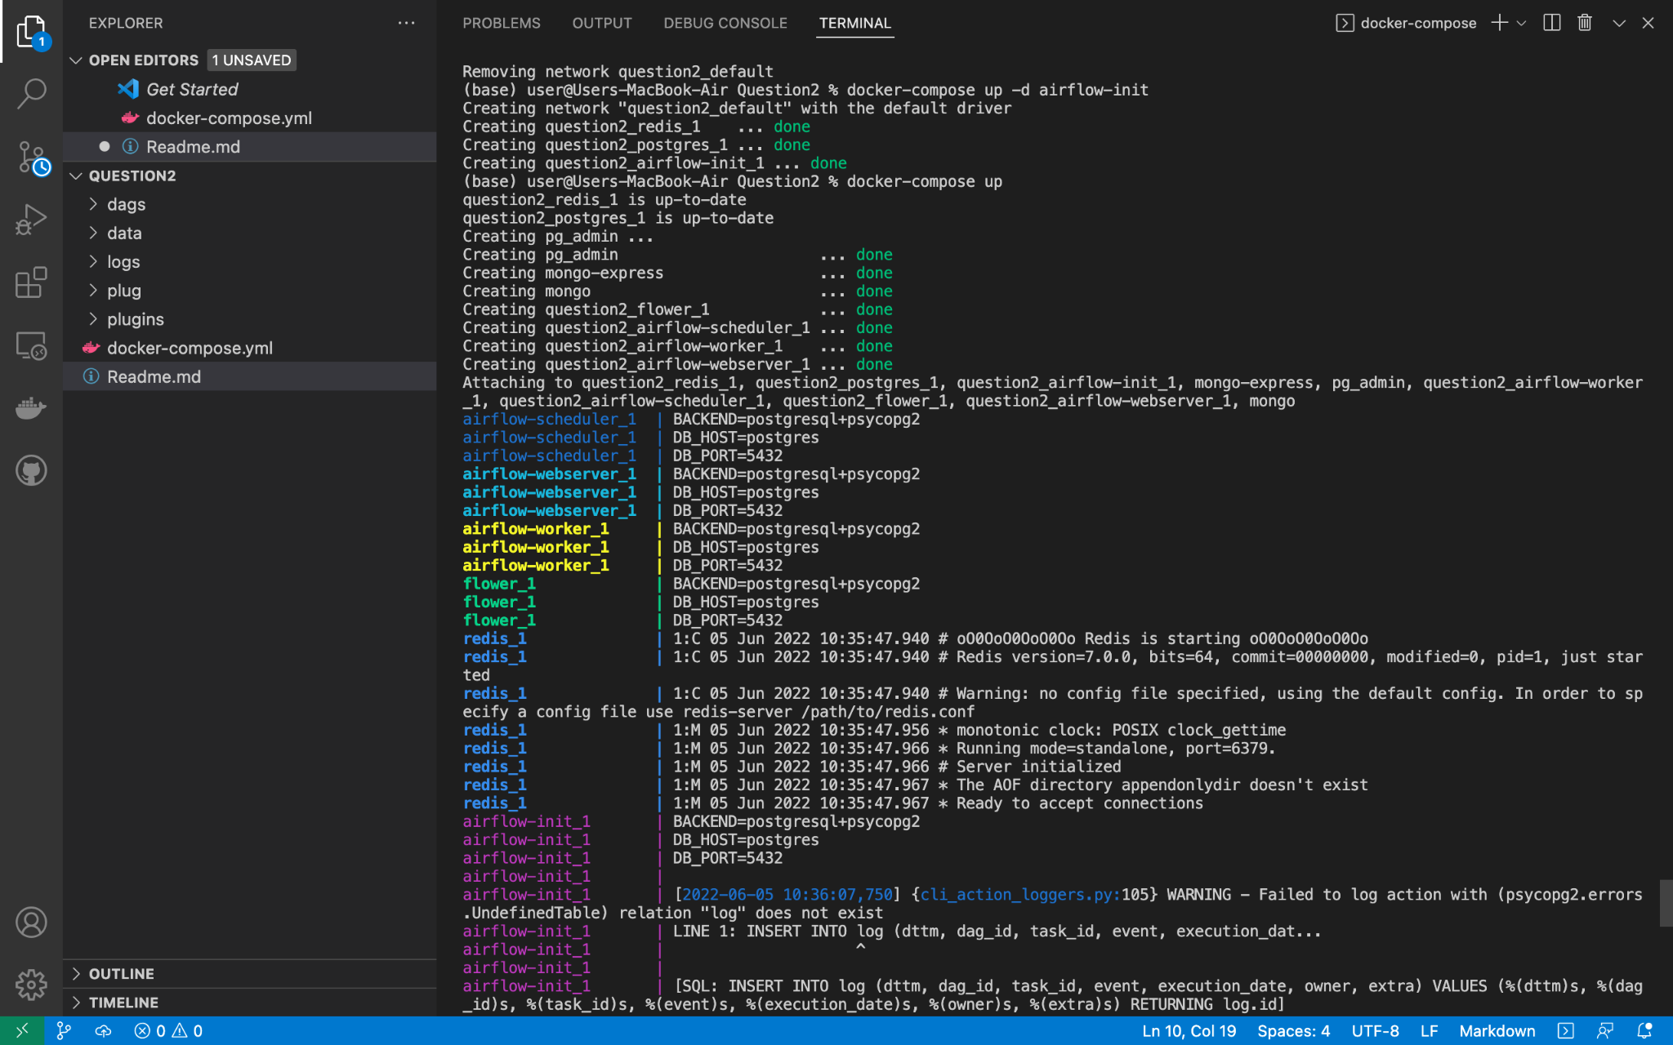
RUN THE DOCKER COMPOSE UP

Slide 4
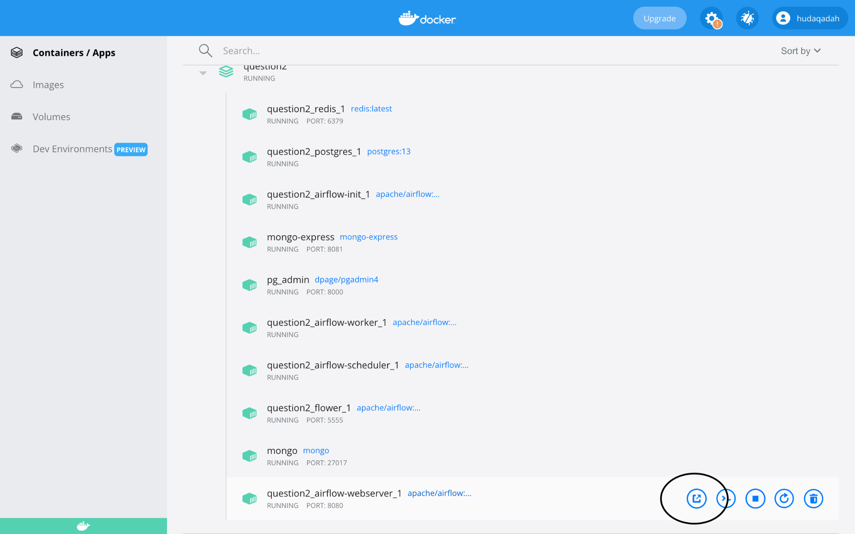
OPEN DOCKER and open web browsers from there

Slide 5
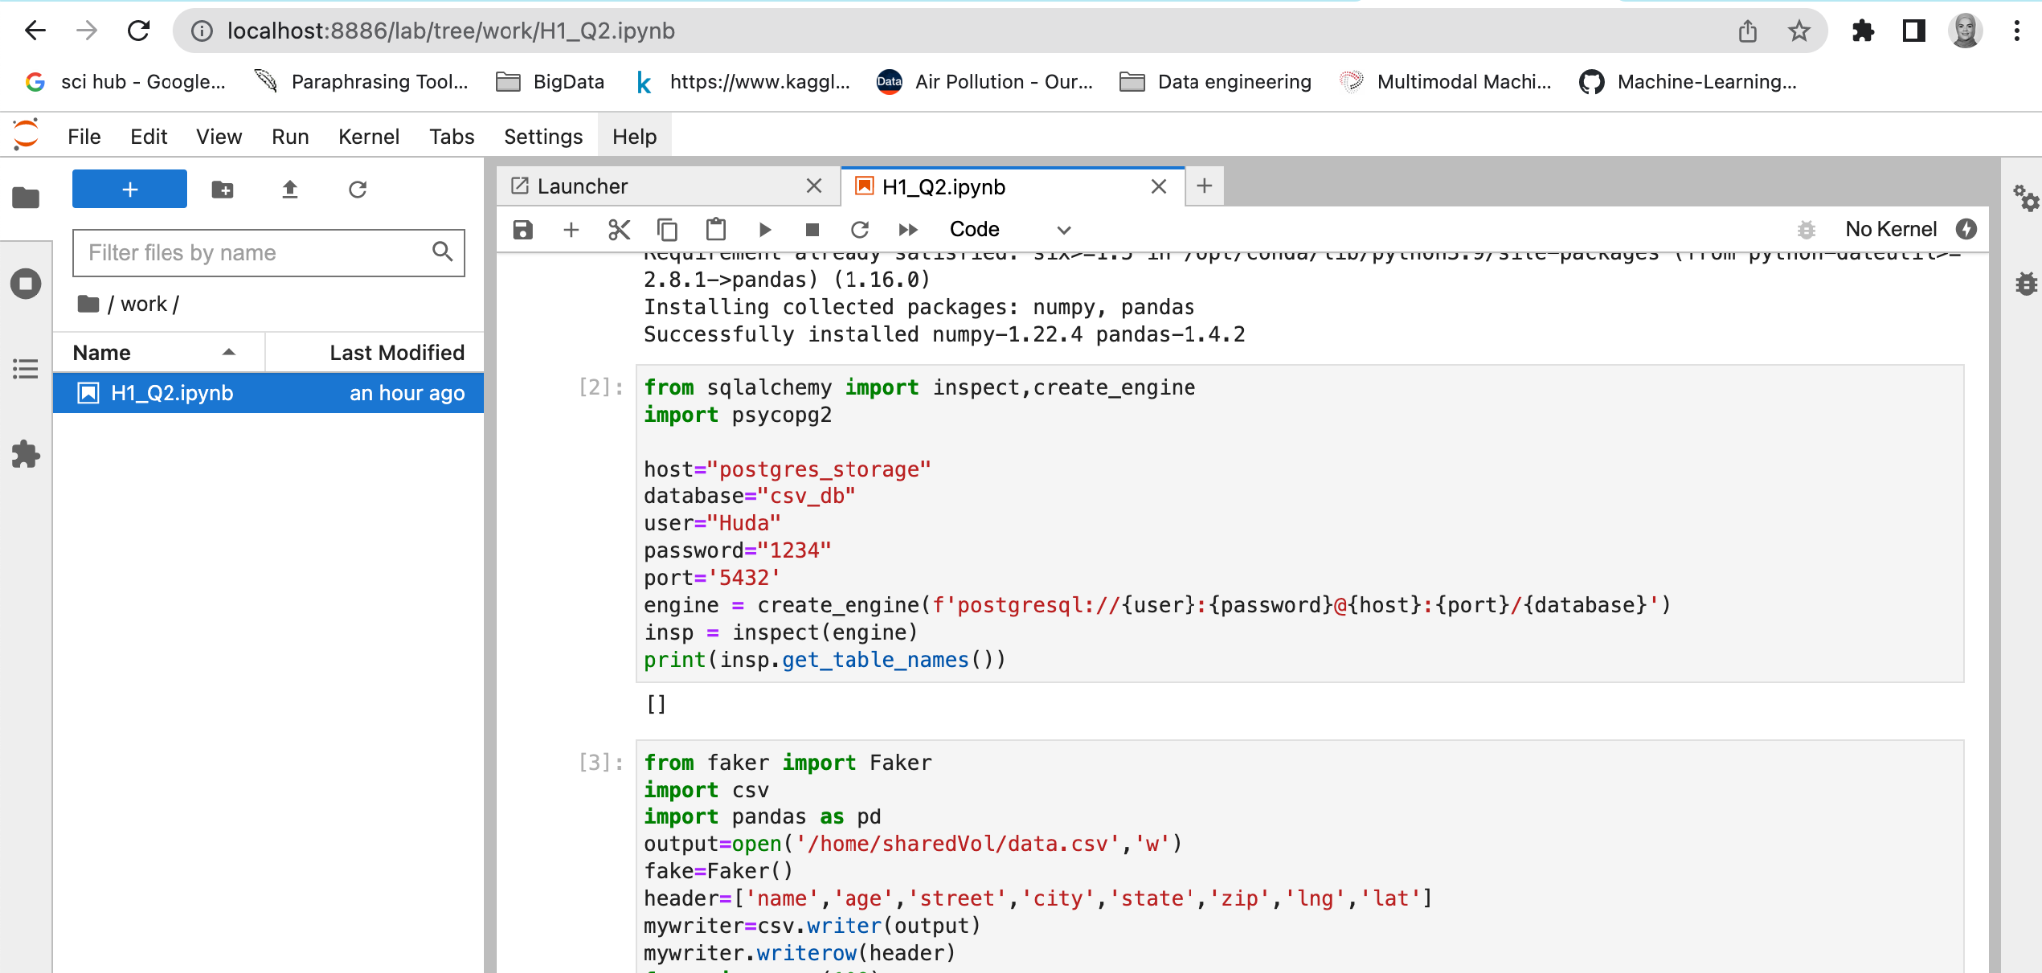
Prepare data using Faker and Save it to CSV File,inside the container

Slide 6
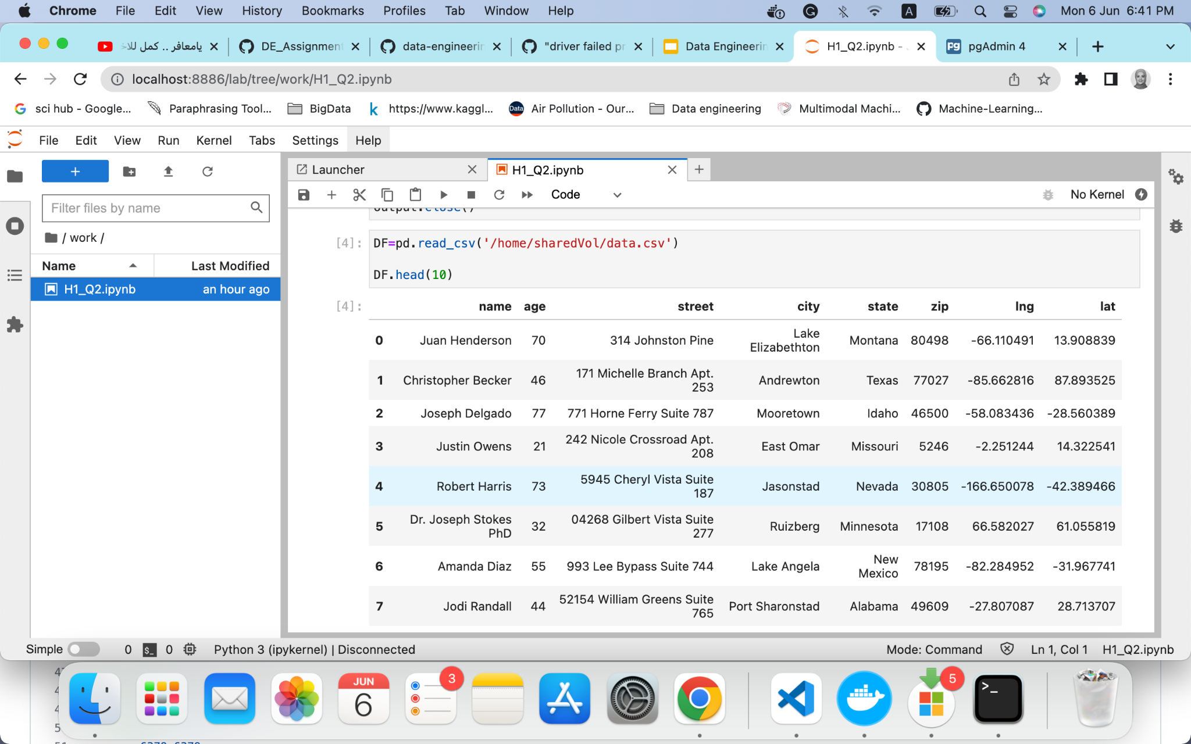

Slide 7
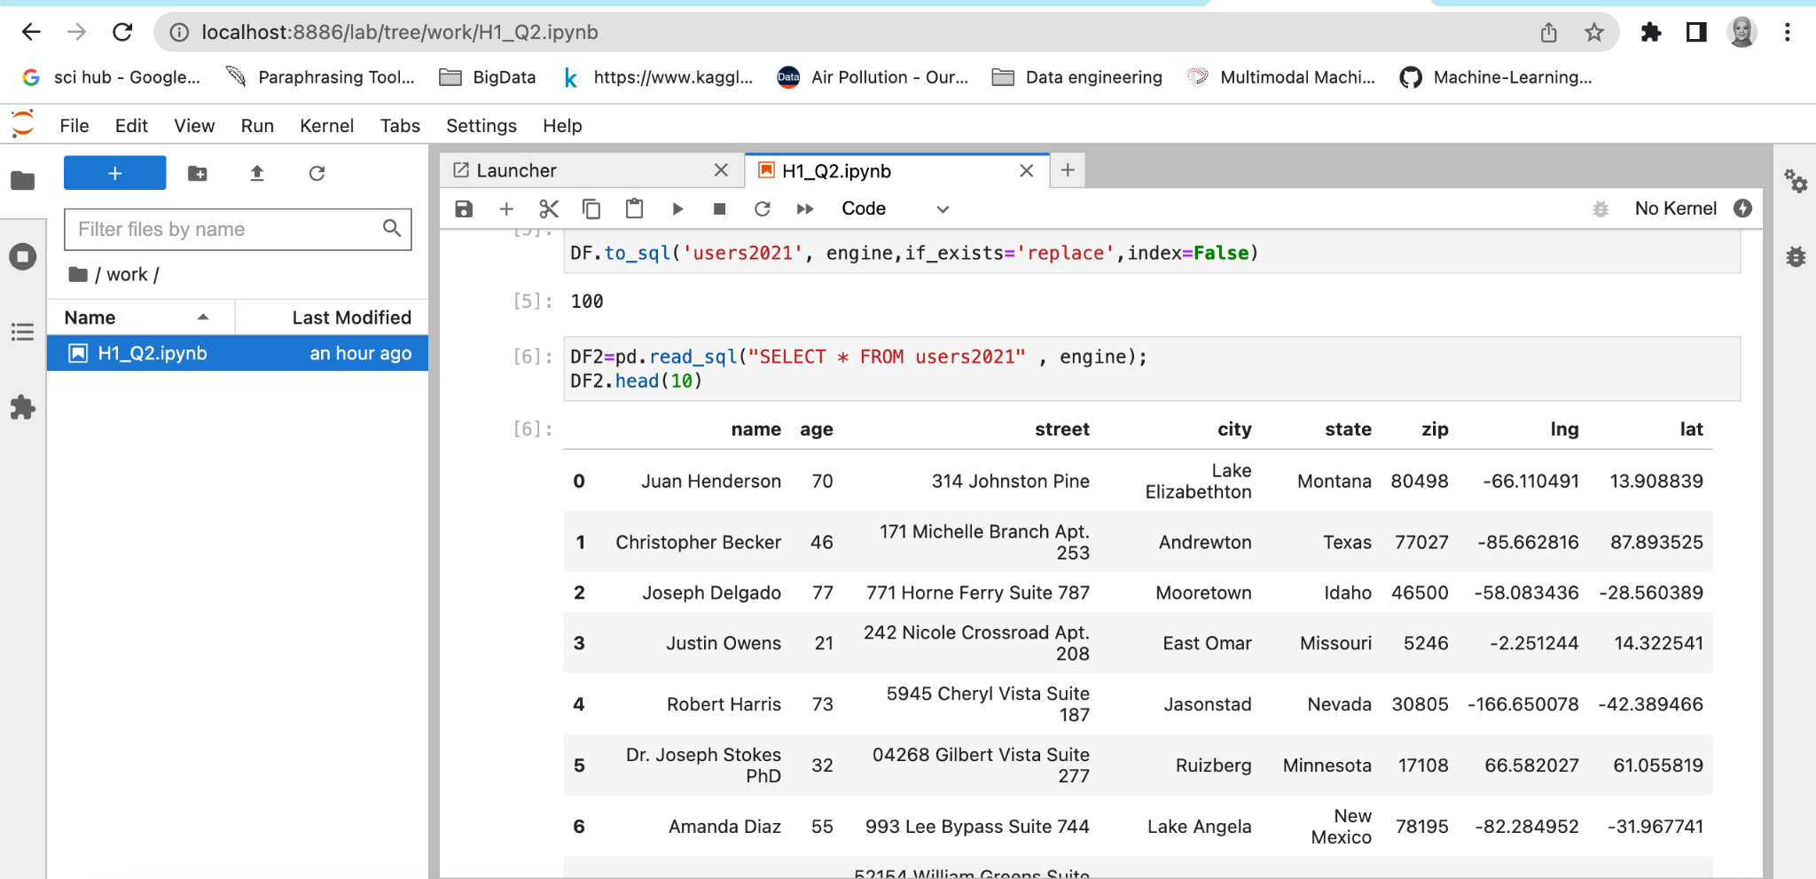
Pushing the data Into the postgres DB & verify by reading it

Slide 8
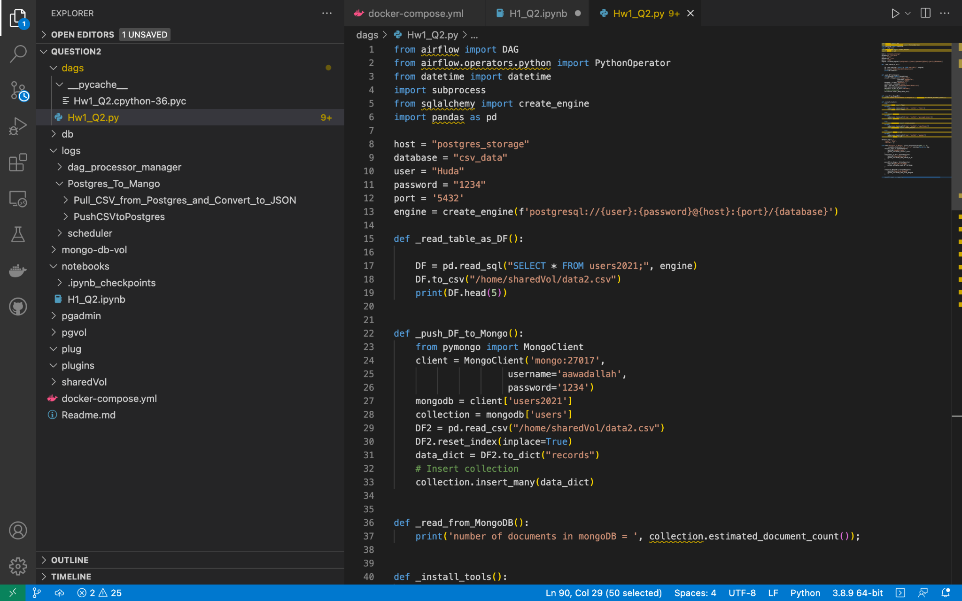
Make the Dag file and Upload it inside the dags directory in airflow container

Slide 9
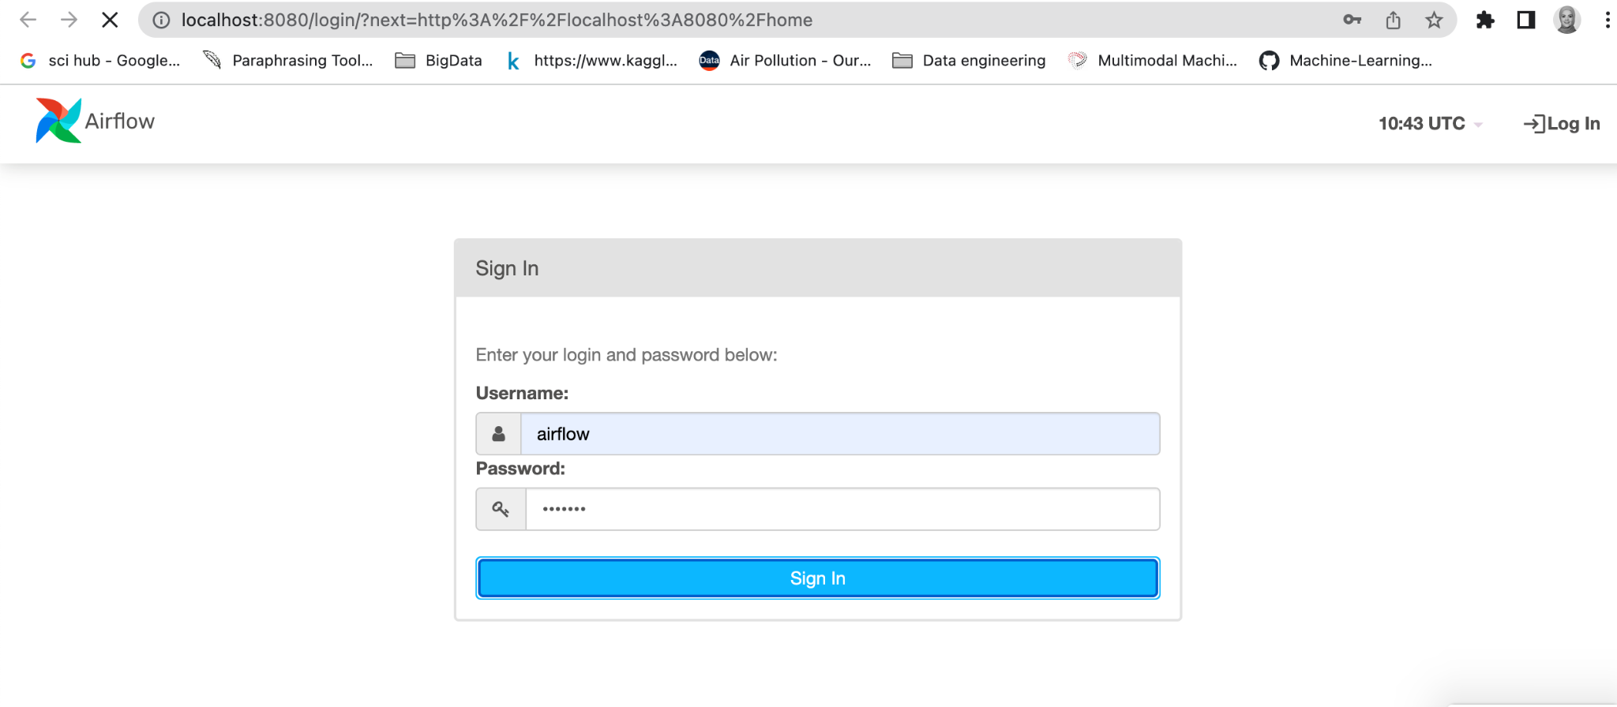
Sign in into the airflow

Slide 10
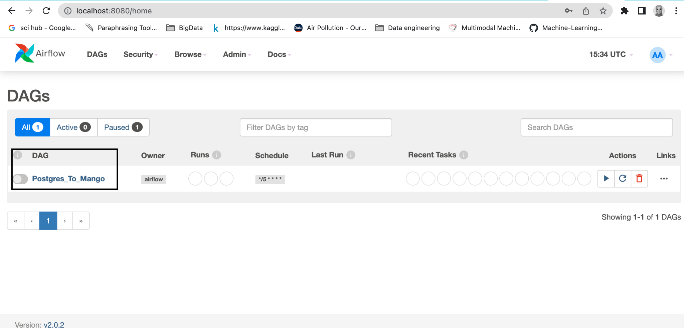
Set the airflow to active

Slide 11
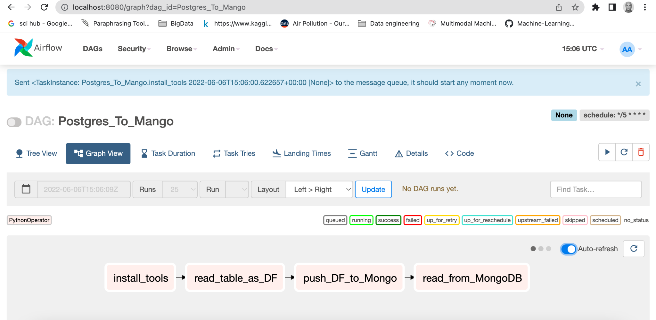
From graph view you can run the flow

Slide 12
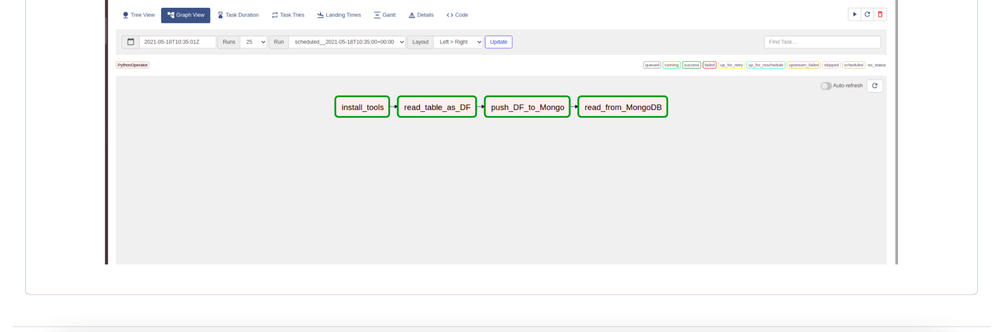
The airflow has worked successfully

